Slide 1
BUSINESS ANALYTICS

Slide 2
TYPES
The main types of business analytics are
These types build on each other, progressing from understanding past events to influencing future outcomes.
Descriptive (what happened)
Diagnostic (why it happened)
Predictive (what might happen)
Prescriptive (what should be done). These types build on each other, progressing from understanding past events to influencing future outcomes. A fifth type
Cognitive Analytics, incorporates AI and machine learning to further enhance these processes.

Slide 3
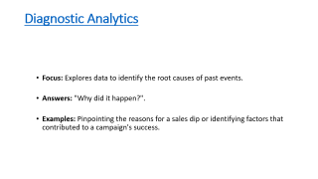
Descriptive Analytics
  Focus: Summarizes historical data to understand past events.
  Answers: "What happened?".
  Examples: Dashboards showing sales trends, reports on website traffic, or tracking customer sign-ups.

Slide 4
Diagnostic Analytics
  Focus: Explores data to identify the root causes of past events.
  Answers: "Why did it happen?".
  Examples: Pinpointing the reasons for a sales dip or identifying factors that contributed to a campaign's success.

Slide 5
Predictive Analytics
  Focus: Uses statistical models and machine learning to forecast future trends and behaviors.
  Answers: "What might happen next?".
  Examples: Forecasting sales for the next quarter or predicting customer churn.

Slide 6
Prescriptive Analytics
  Focus: Suggests specific actions and recommendations to achieve desired outcomes.
  Answers: "What should we do?".
  Examples: Providing optimal strategies to improve business processes based on data-driven insights.

Slide 7
Cognitive Analytics
  Focus: Incorporates advanced AI, machine learning, and deep learning techniques to analyze data in more complex ways.
  Answers: A combination of the questions above, often with more sophisticated reasoning and insights.
  Examples: Enhancing the accuracy and speed of predictive models or uncovering hidden patterns in large datasets.

